Slide 1
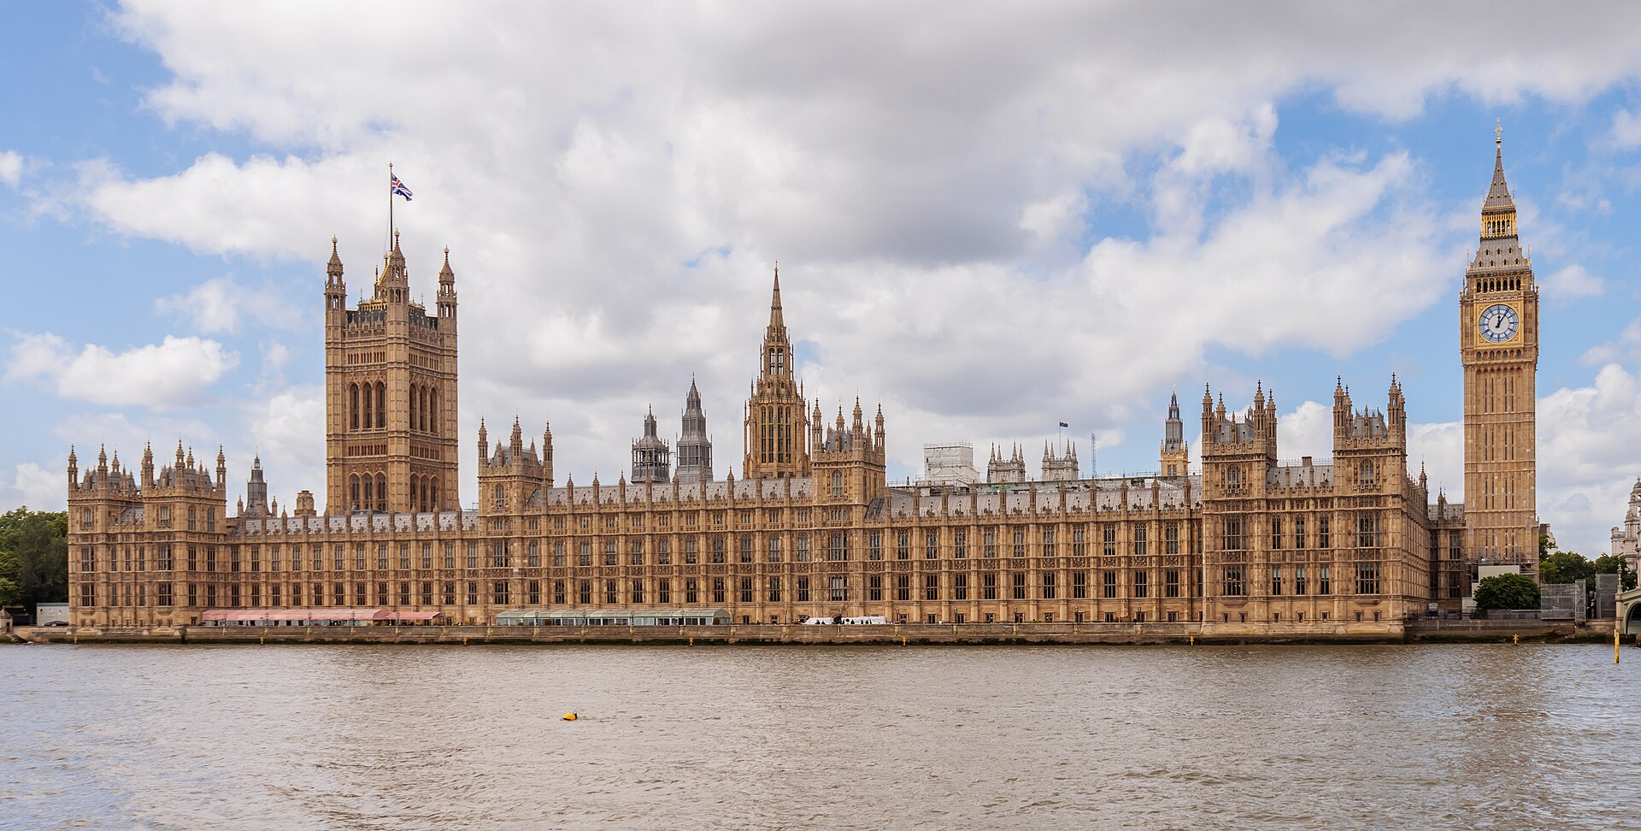
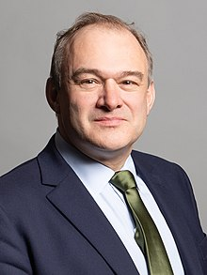
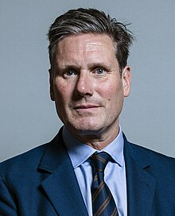
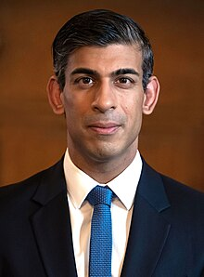

Election ‘24 in Data:
A Data Storytelling project by Matthew Fricker

Slide 2
The Task
Exploring the various models made for the 2024 UK general election
Comparing and contrasting the different models against each other
Attempting to build my own model to predict the result
Evaluating different models against the real result

Slide 3
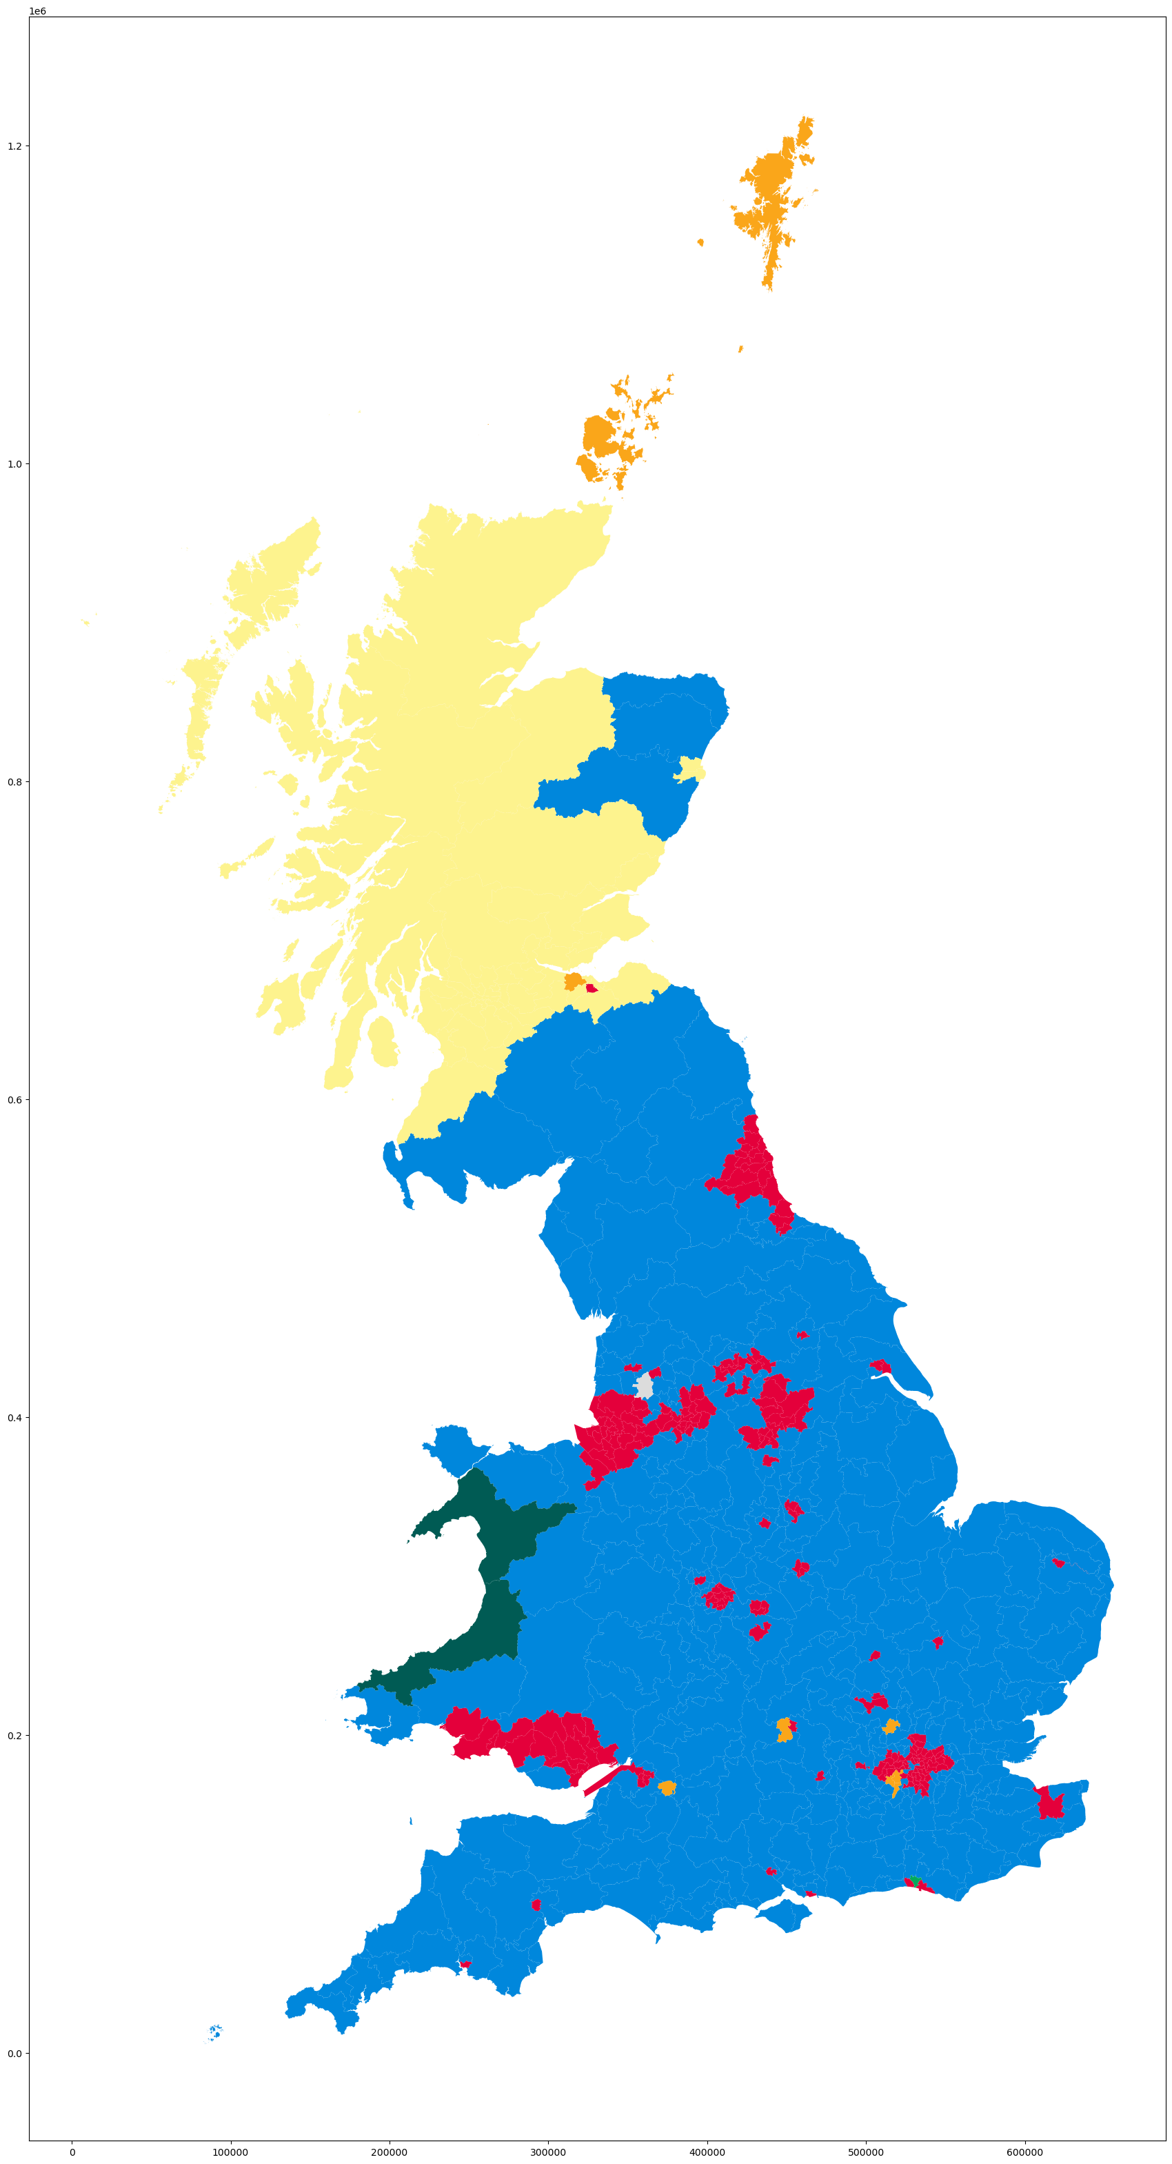
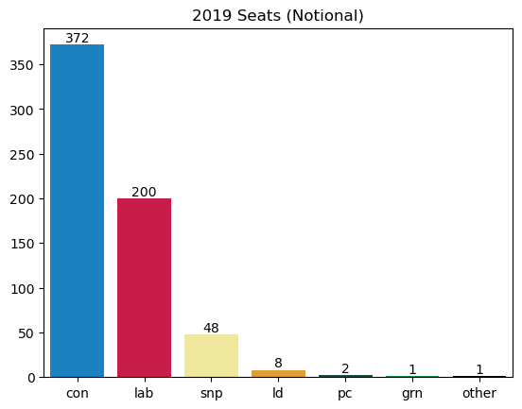
Last time…

Slide 4
The models
The Forecasters:
Britain Predicts
Election Maps UK
The Economist
The MRPs:
YouGov
Survation
More in Common

Slide 5
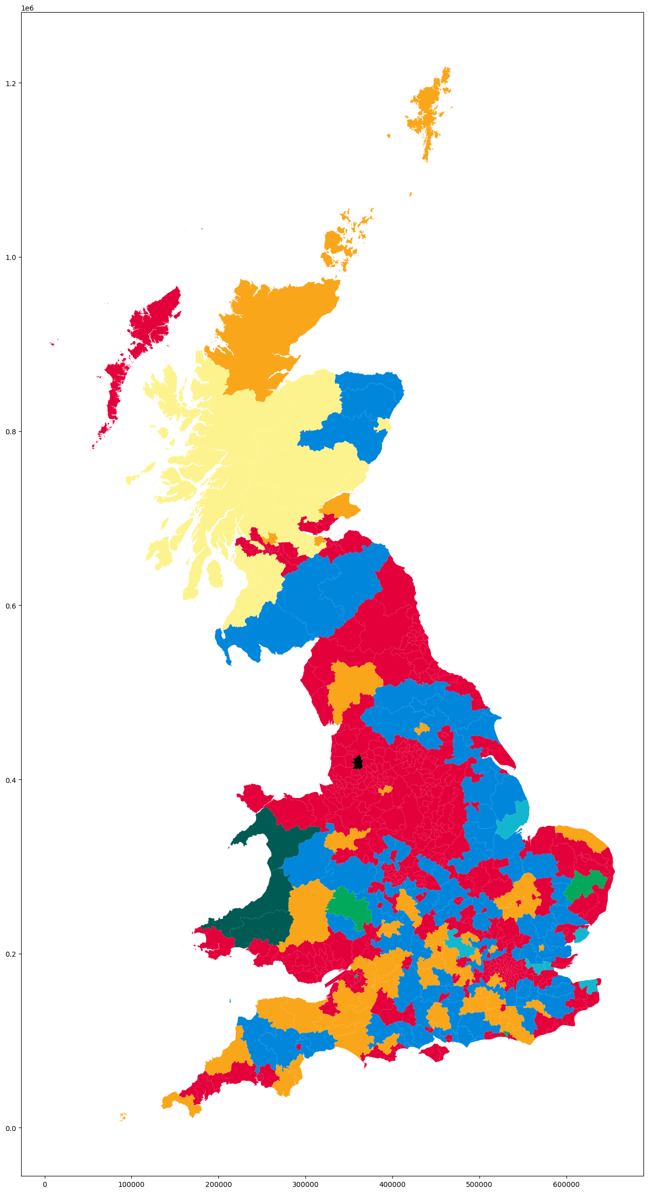
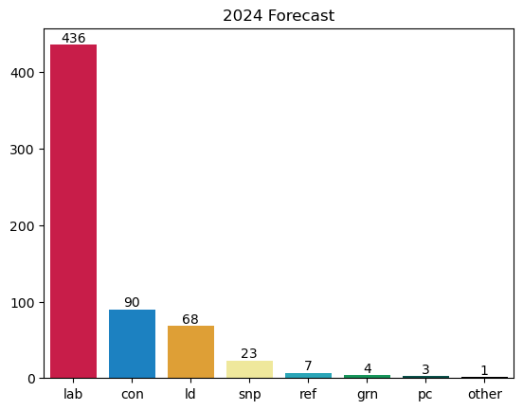
Britain Predicts

Slide 6
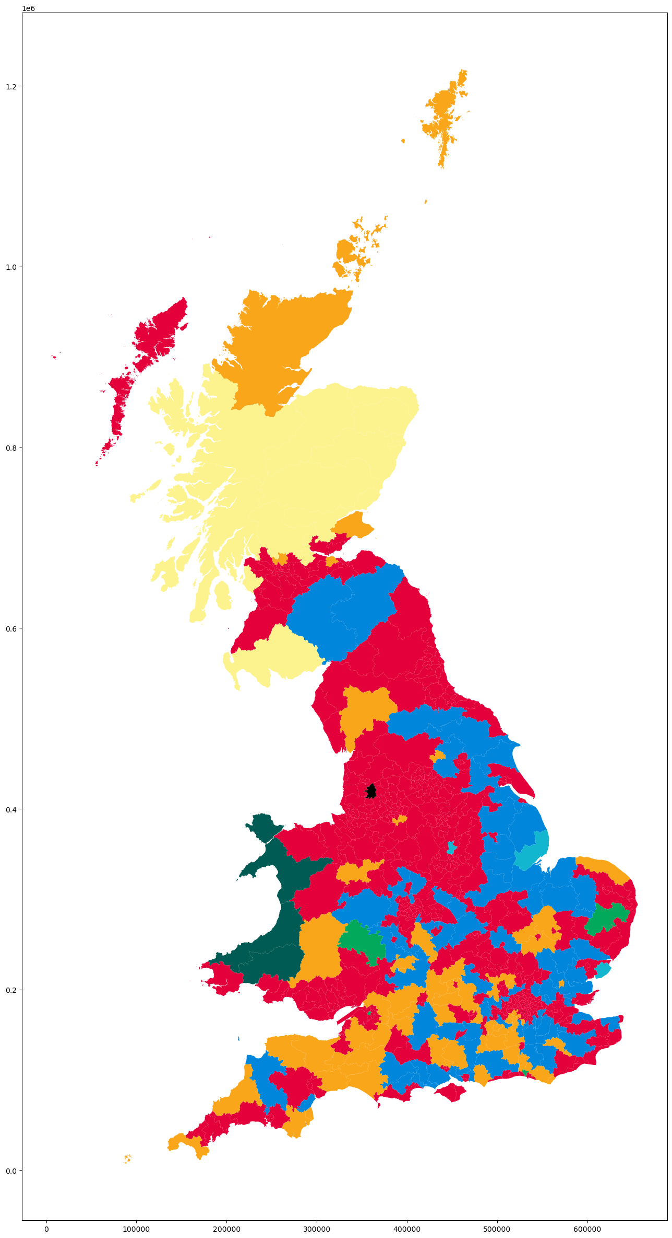

Election Maps UK

Slide 7
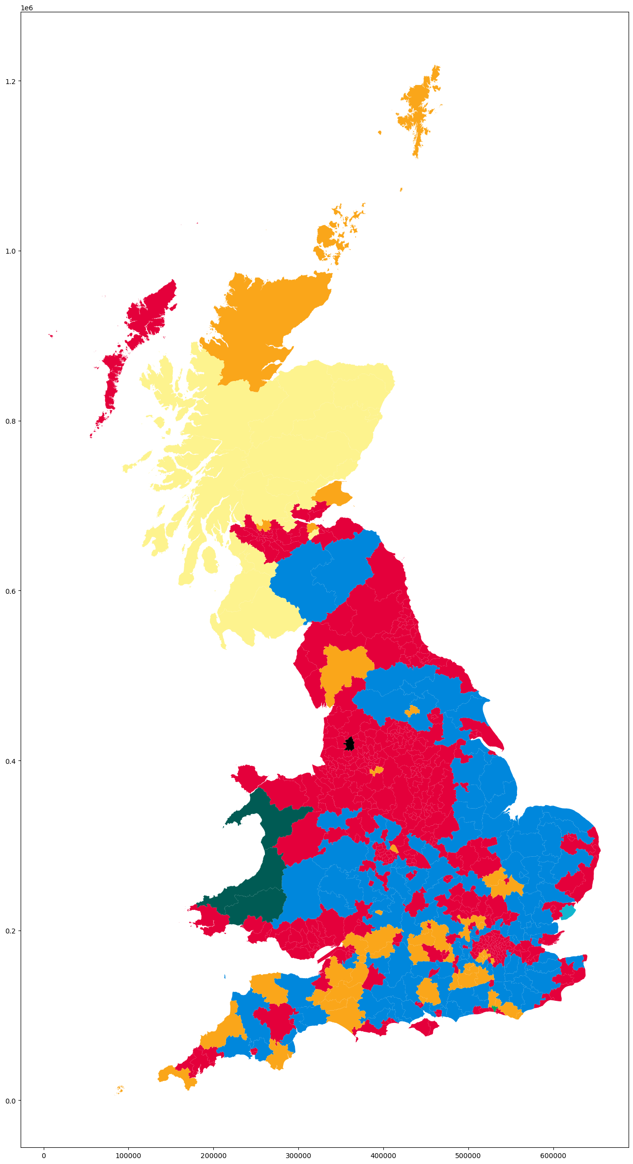
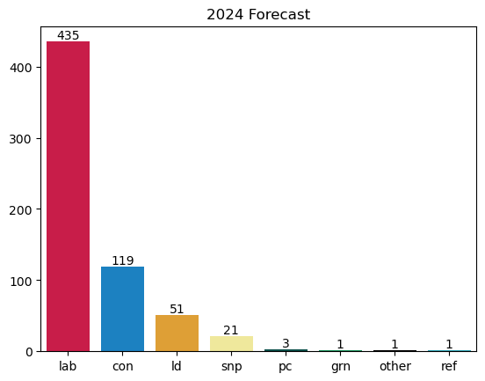
The Economist

Slide 8
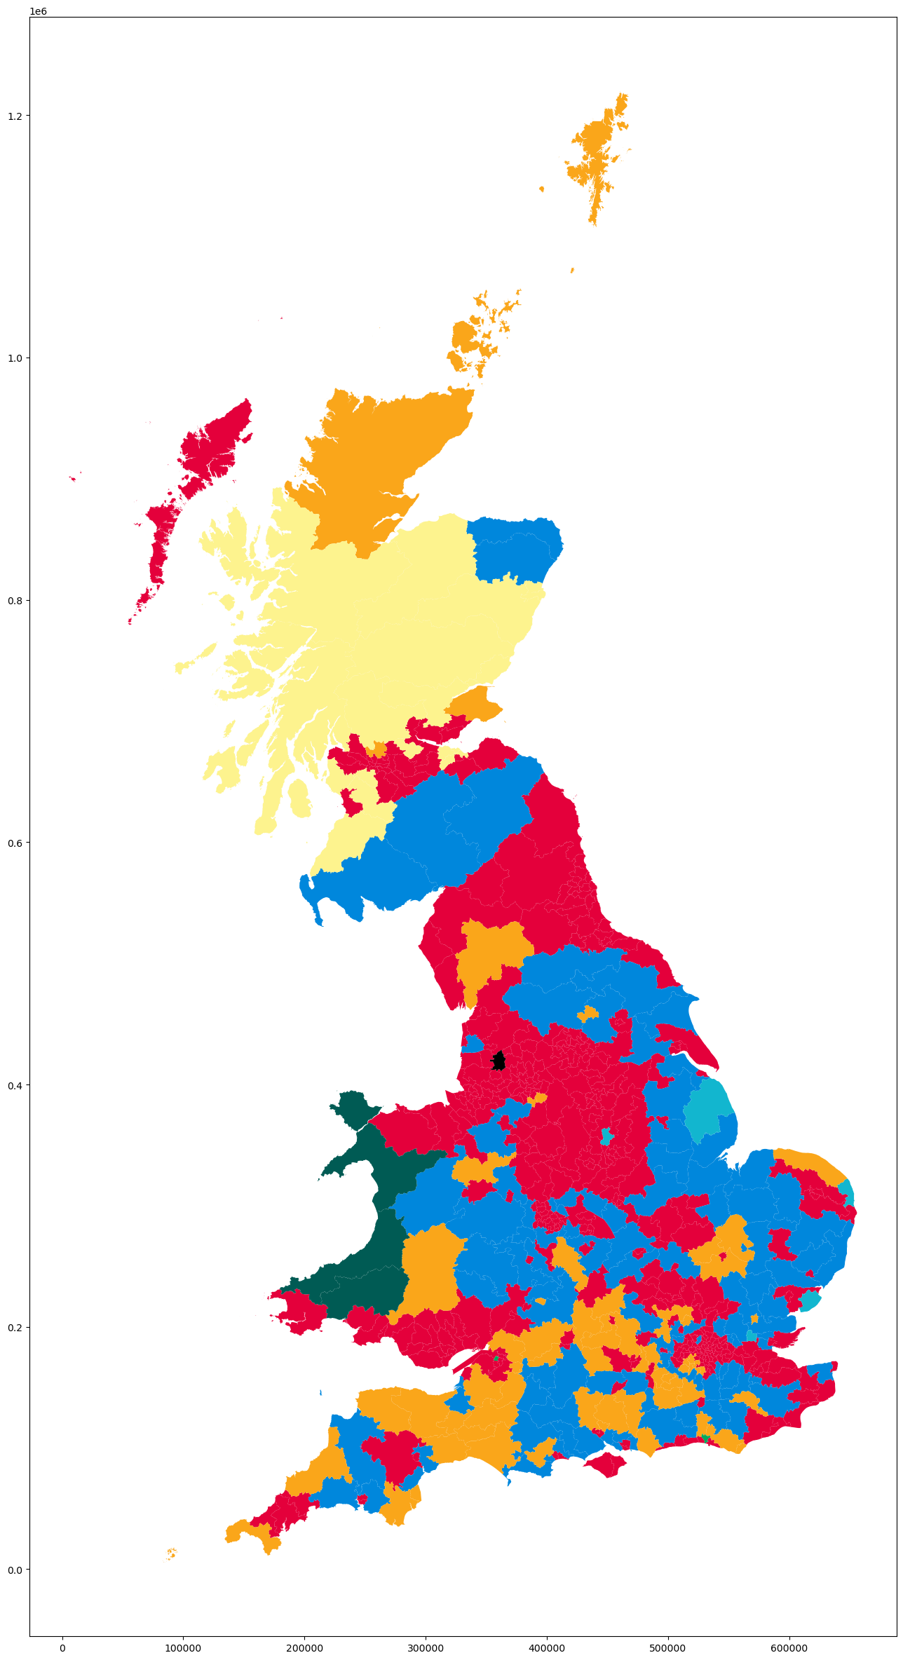
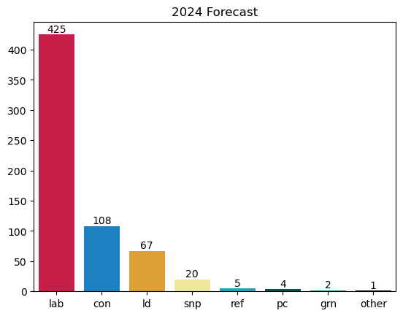
YouGov

Slide 9
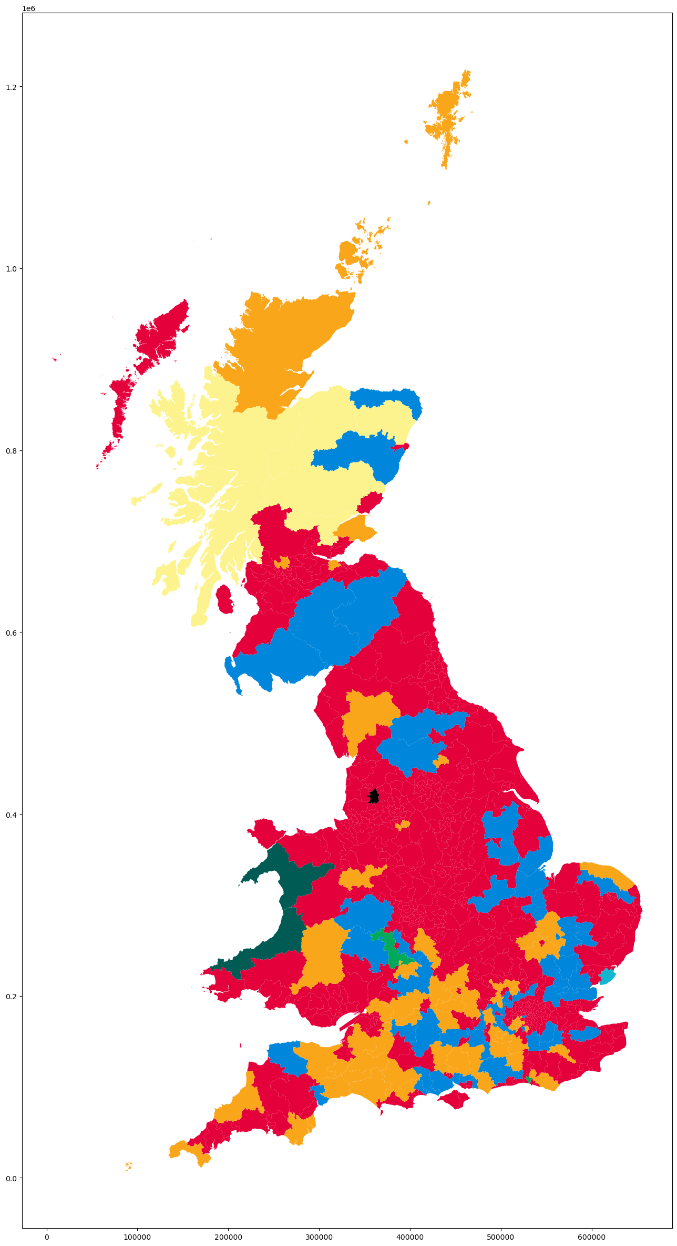
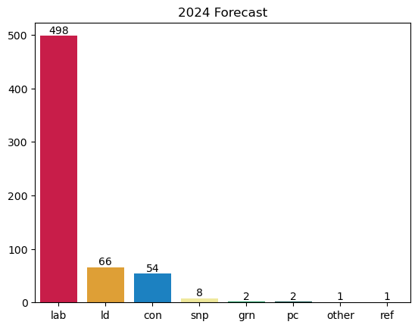
Survation

Slide 10
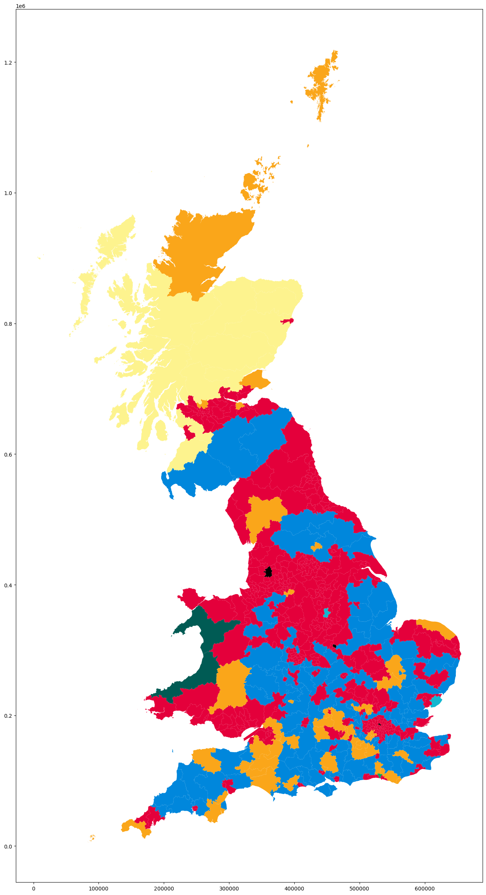

More in Common

Slide 11
Comparing the models – Where they agree
471 of 632 seats had unanimous agreement
Labour and the Lib Dems making gains at the expense of the Conservatives
Nigel Farage winning in Clacton
SNP losing seats to Labour in the central belt of Scotland

Slide 12
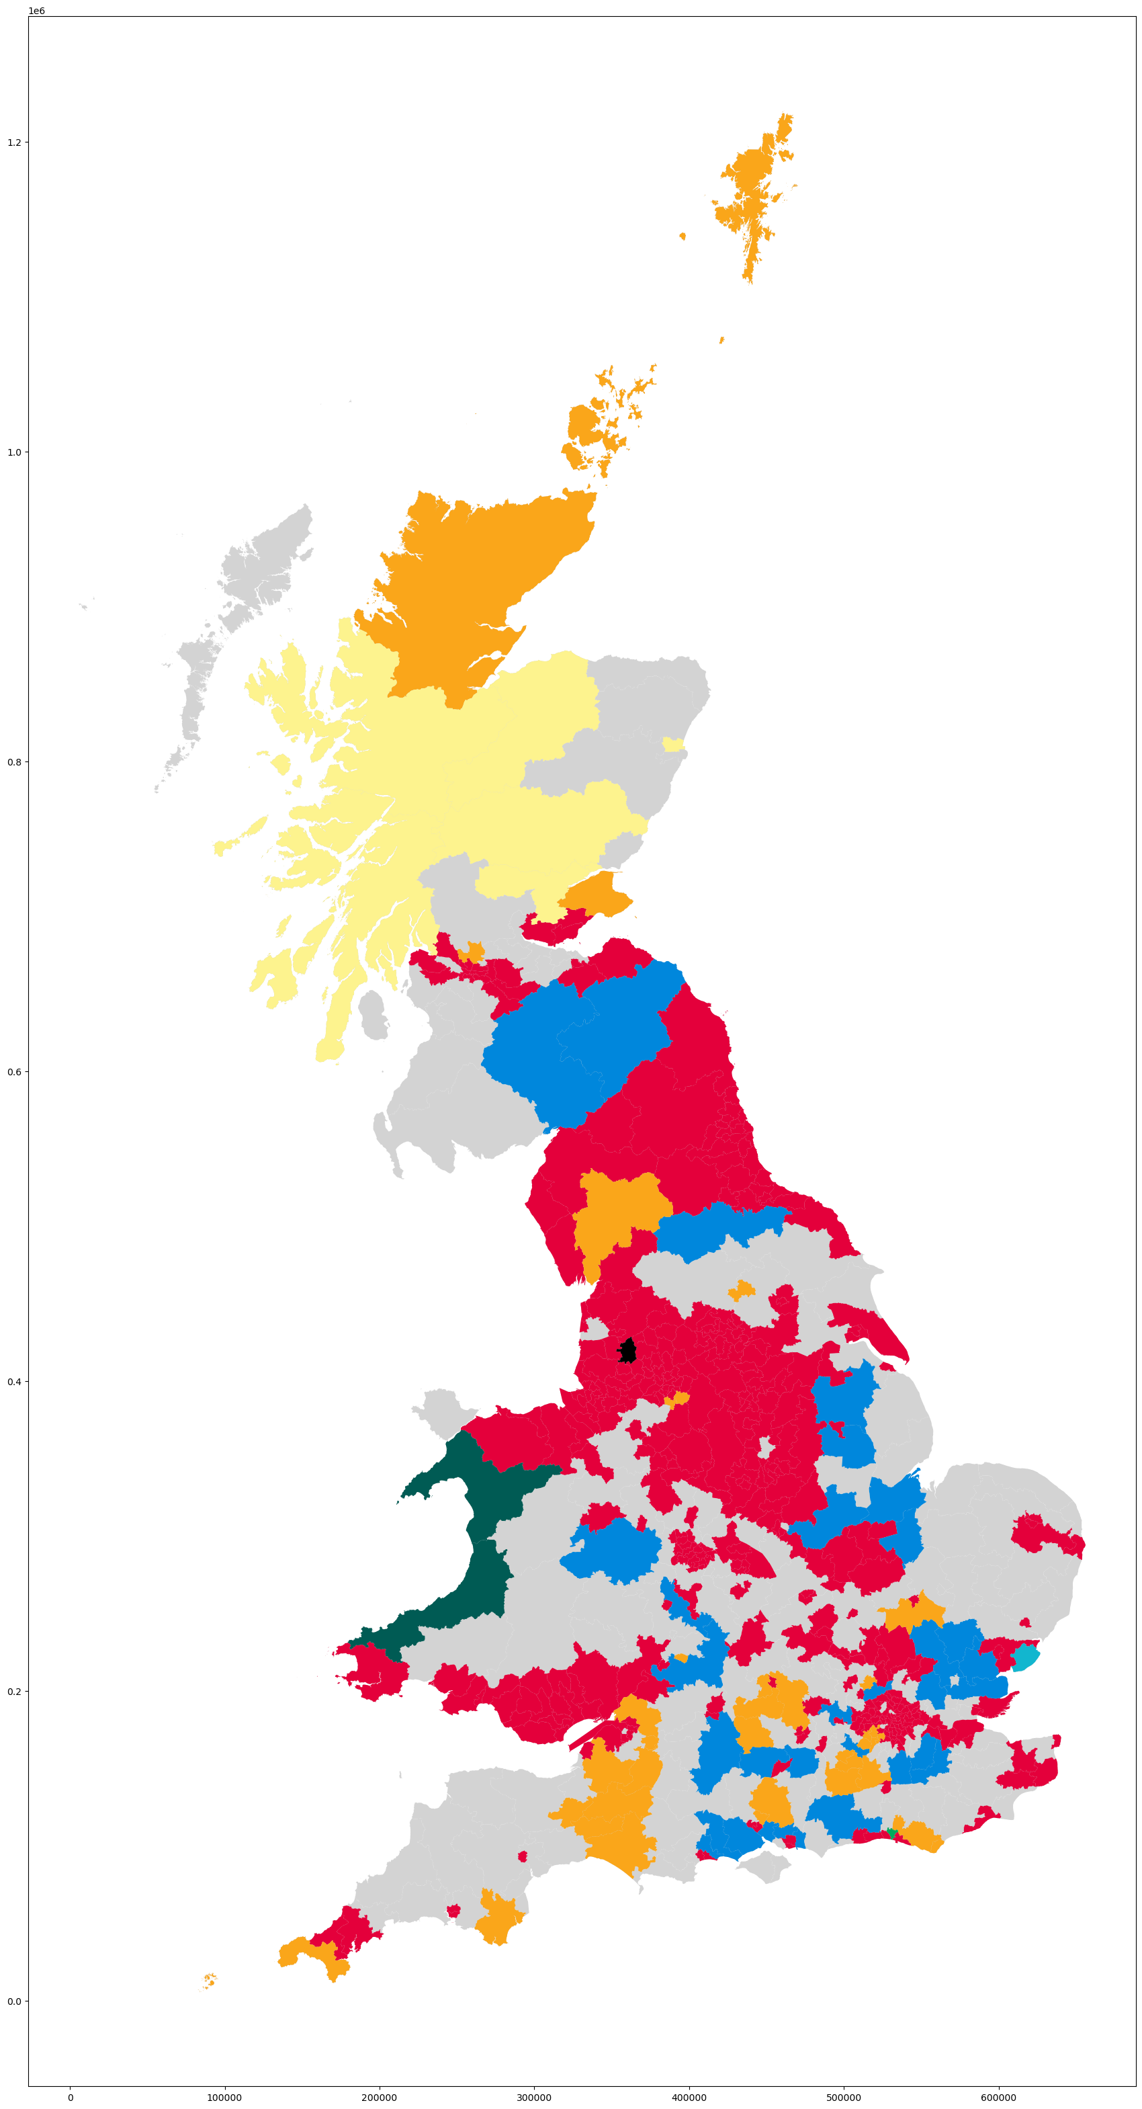
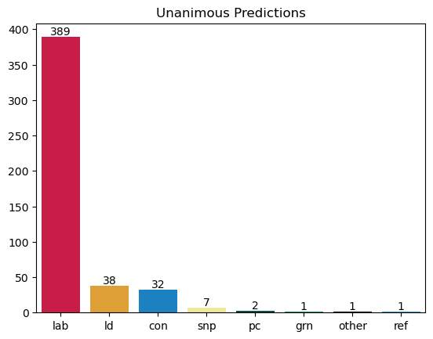
Where they all agree

Slide 13
Comparing the models – Where they disagree
Scale of the swing to Labour / Lib Dems
Where and if Reform will make more gains
Tories in Scotland

Slide 14
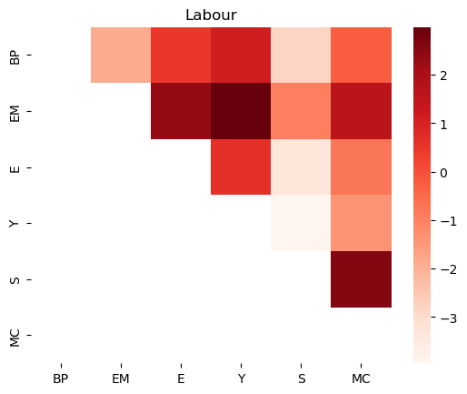
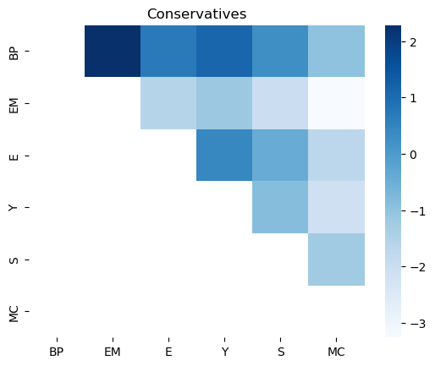
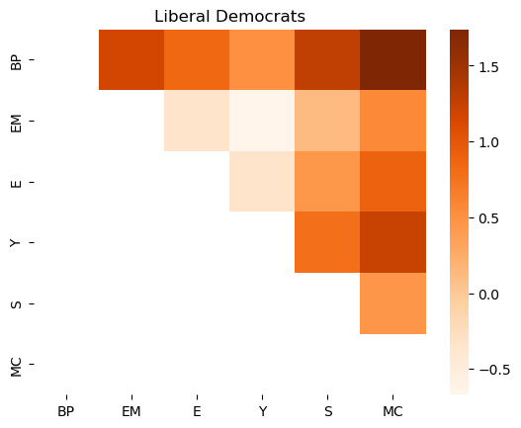
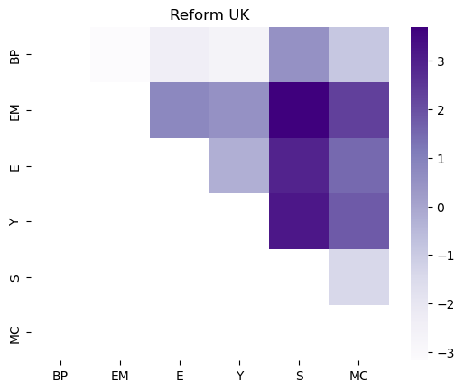
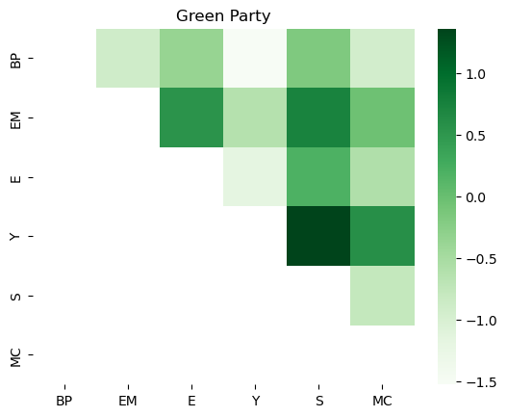

Slide 15
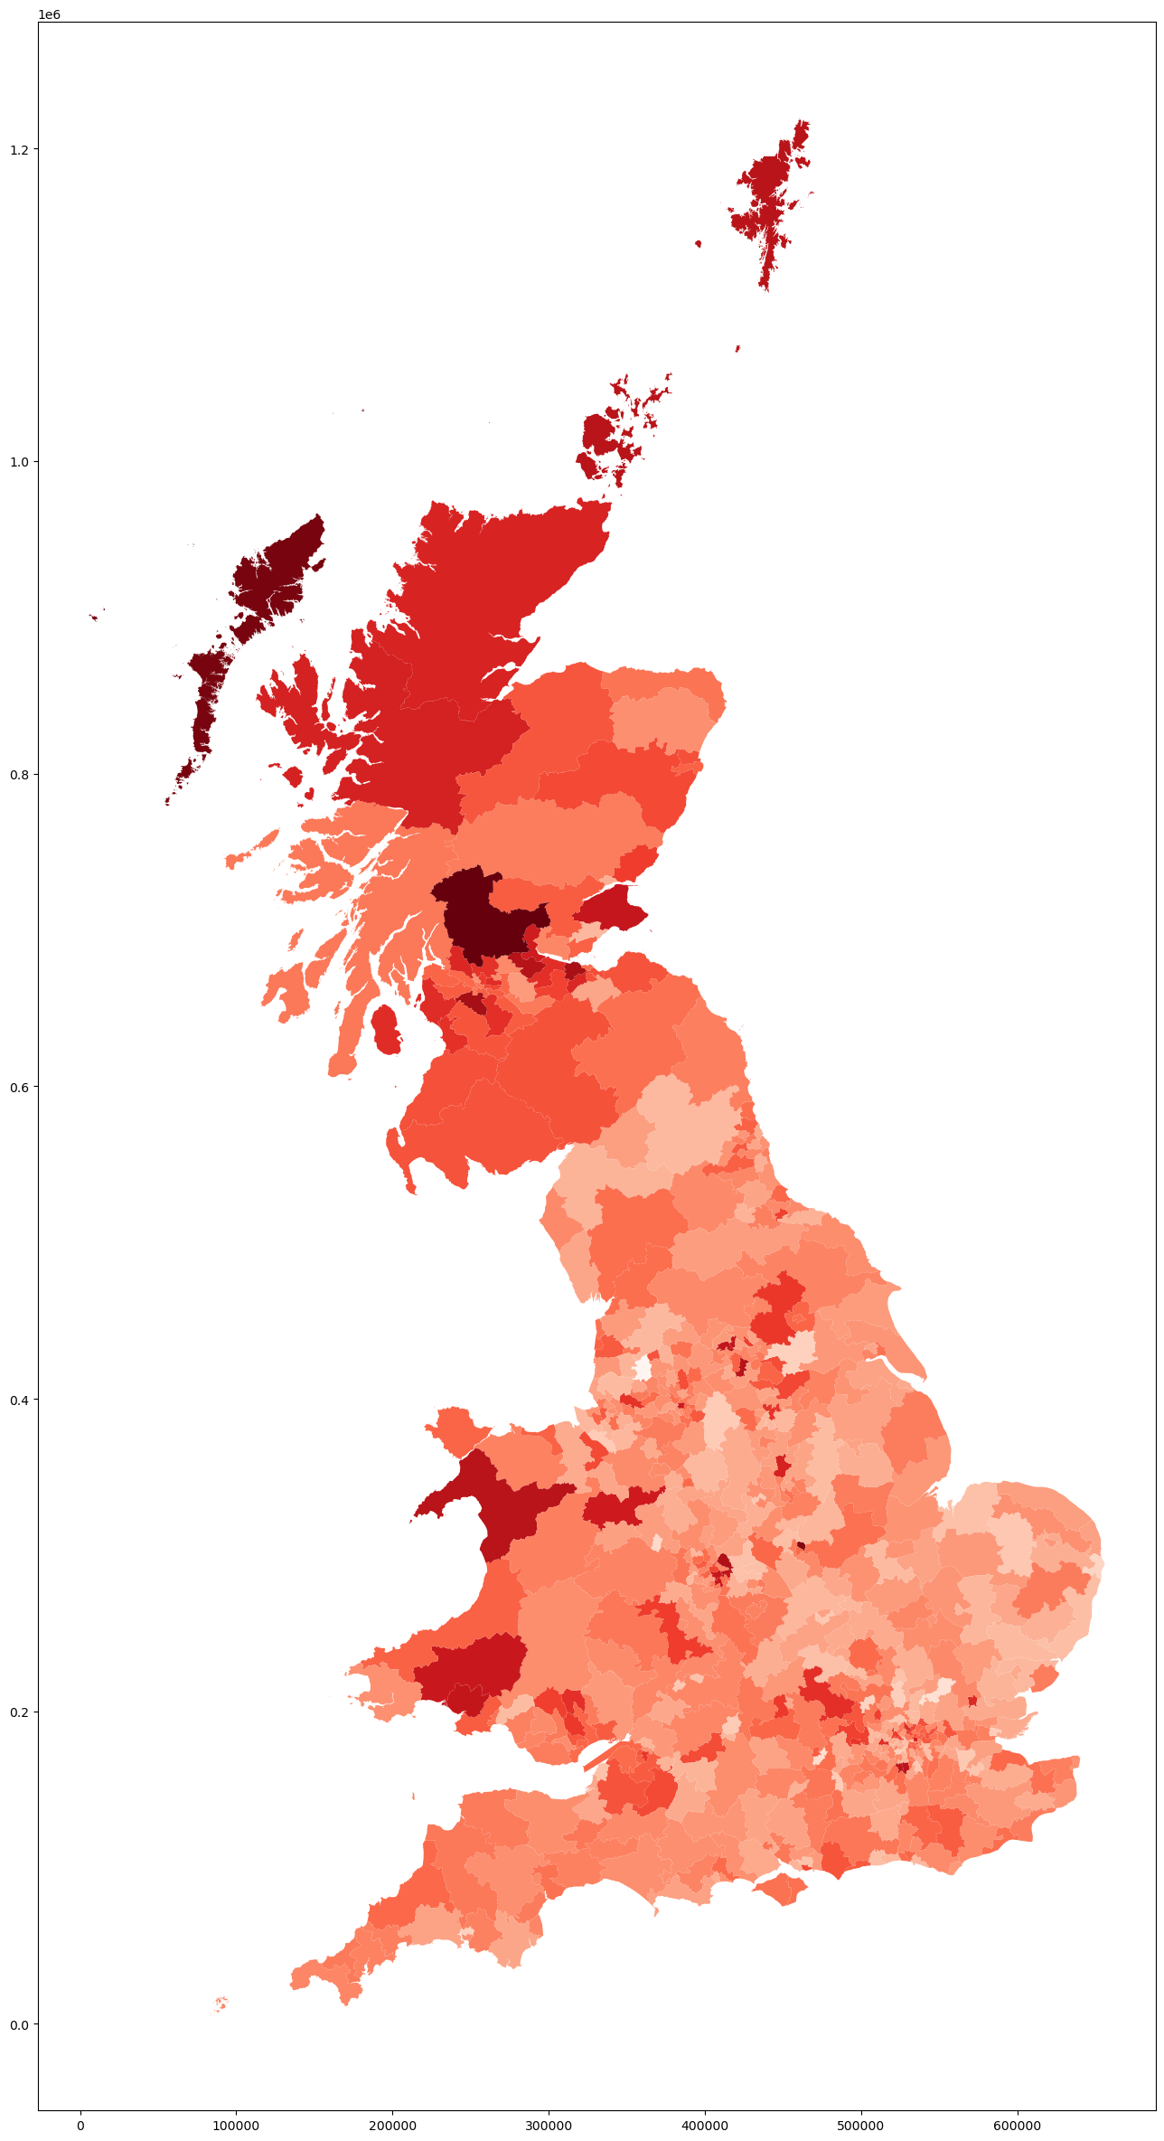
Biggest polling differences
Stirling and Strathallan
Na h-Eileanan an Iar
Leicester East
East Renfrewshire
Edinburgh West
Sutton Coldfield
Falkirk
Dewsbury and Batley
Dwyfor Merionnydd
Orkney and Shetland

Slide 16
My Models
Strong Transition Model
Linear Regression
Aggregate of other models

Slide 17
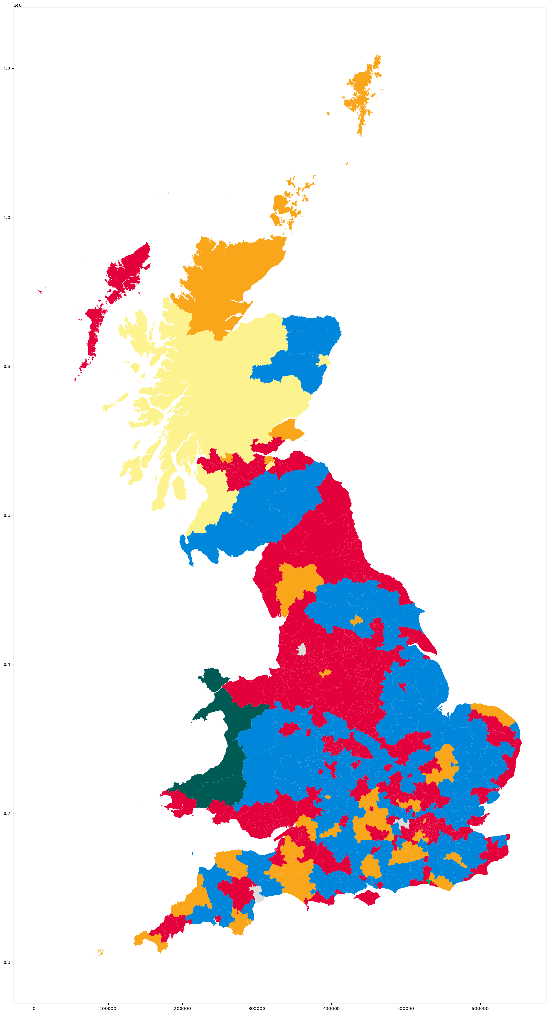
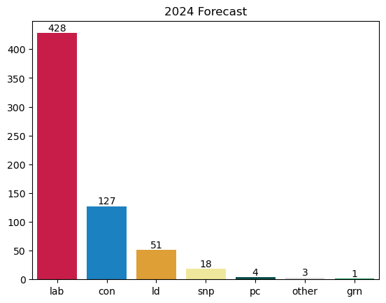
Strong Transition Model

Slide 18
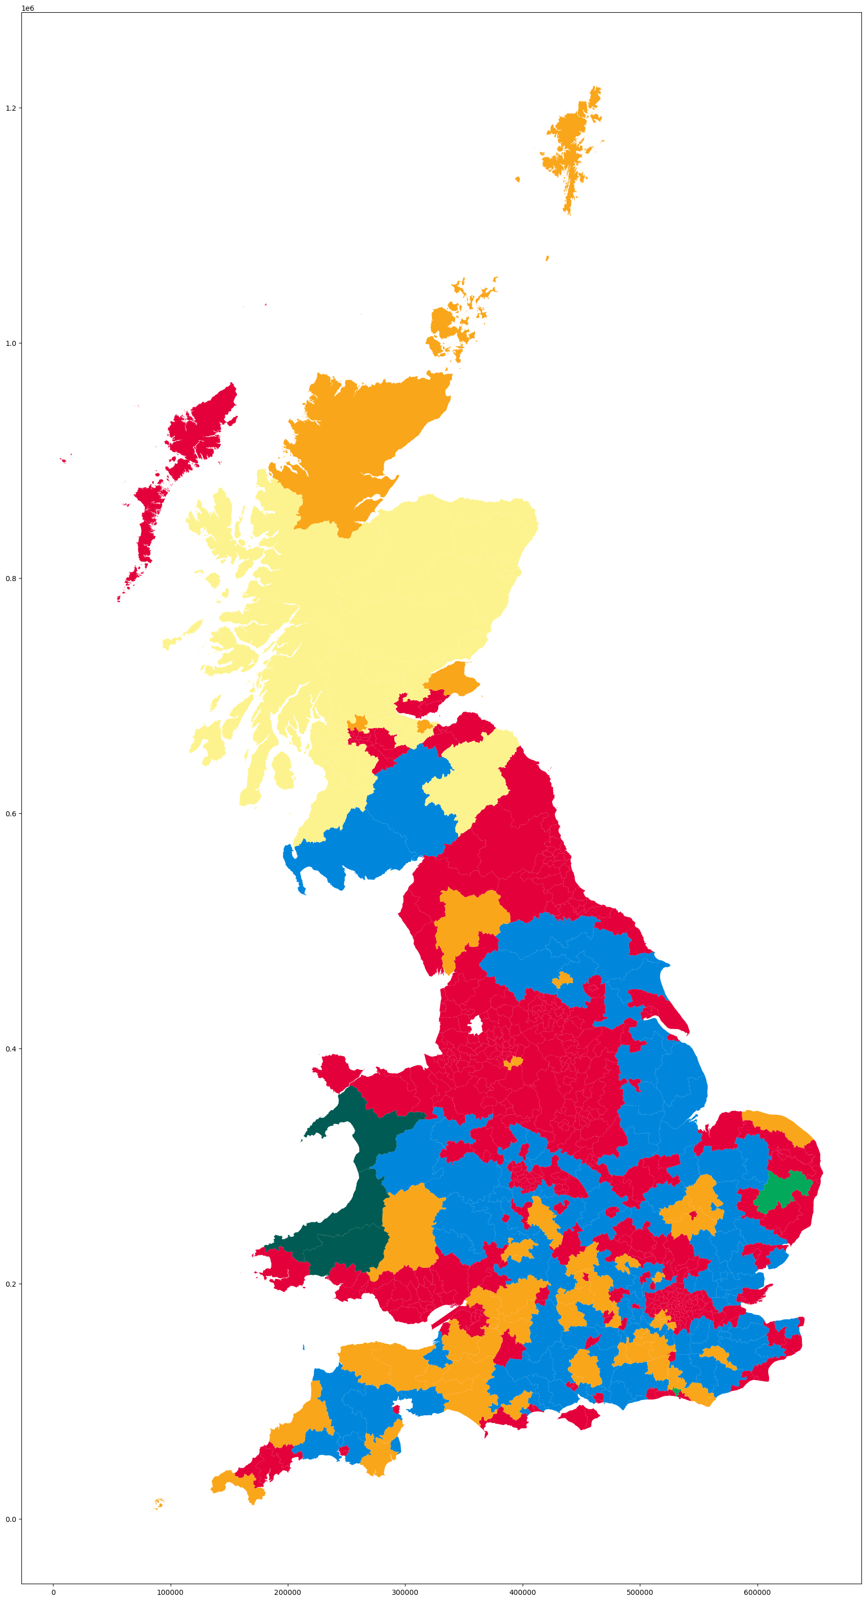
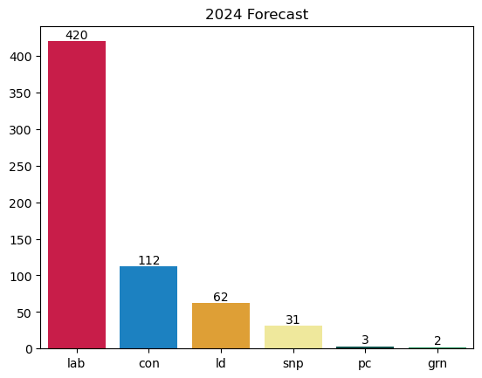
Linear Regression

Slide 19
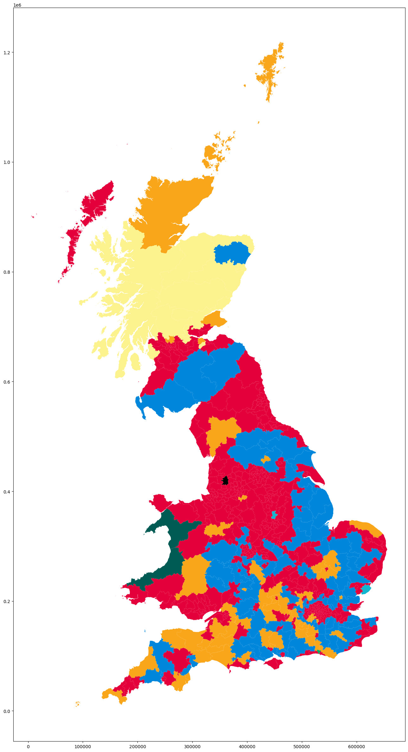
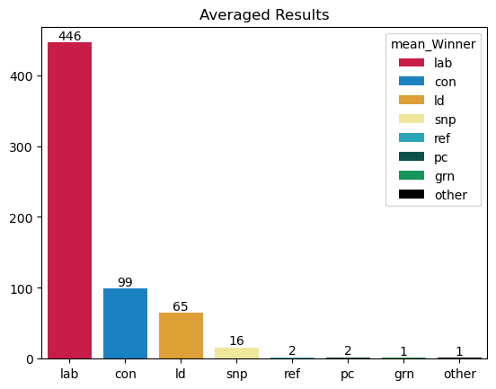
Averaged Model

Slide 20
Accuracy against the Real Result
Britain Predicts: 85.92%
Election Maps UK: 88.77%
The Economist: 86.23%
YouGov: 88.77%
Survation: 82.28%
More in Common: 86.39%
Strong Transition Model: 88.45%
Linear Regression: 84.49%
Mean: 88.45%

Slide 21
